Slide 1
System Timer (SysTick) With Interrupt

Slide 2
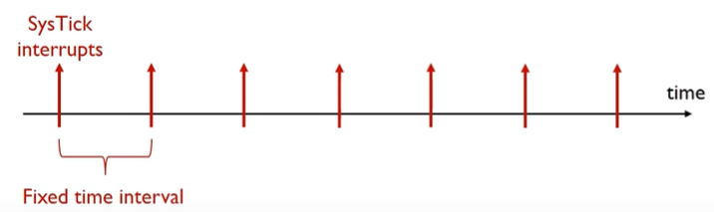
System Timer (SysTick)
System timer is a standard hardware component built into ARM Cortex-M.
Generate SysTick interrupts at a fixed time interval
Example Usages:
Measuring time elapsed, such as time delay function
Executing tasks periodically, such as periodic polling, and OS CPU scheduling

Slide 3
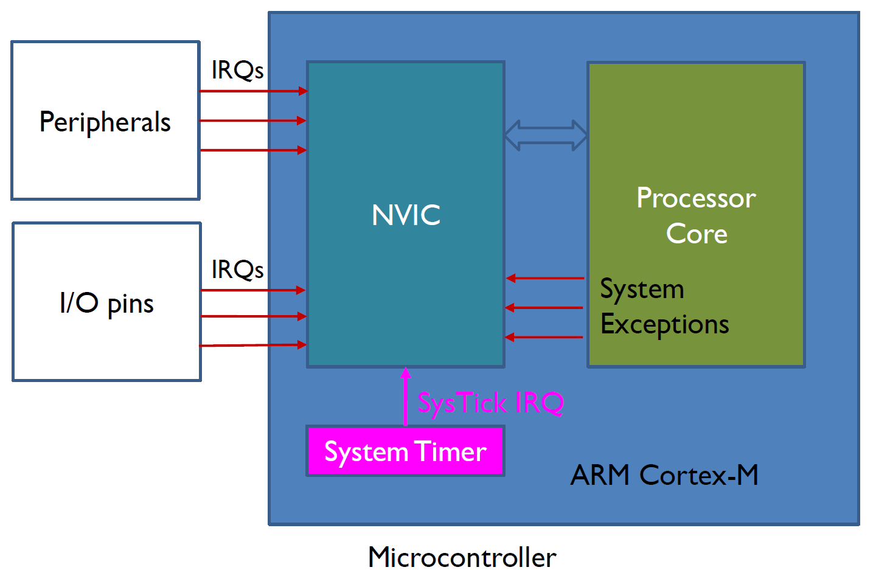
System Timer (SysTick)
System timer is a standard hardware component built into ARM Cortex-M.
System timer is a standard hardware component built into ARM Cortex-M.
This hardware periodically forces the processor to execute the following ISR:
It features:
A 24-bit downcounter
Autoreload capability
Maskable system interrupt generation when the counter reaches 0
Programmable clock source.
void SysTick_Handler(void){
...
}

Slide 4
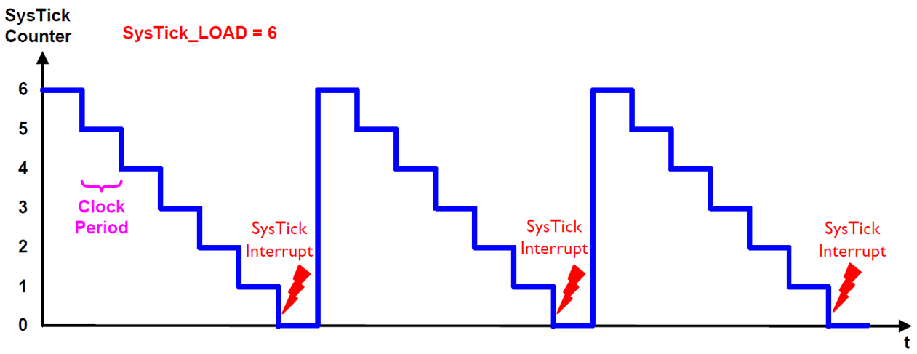
System Timer (SysTick)
System timer is a standard hardware component built into ARM Cortex-M.

Slide 5
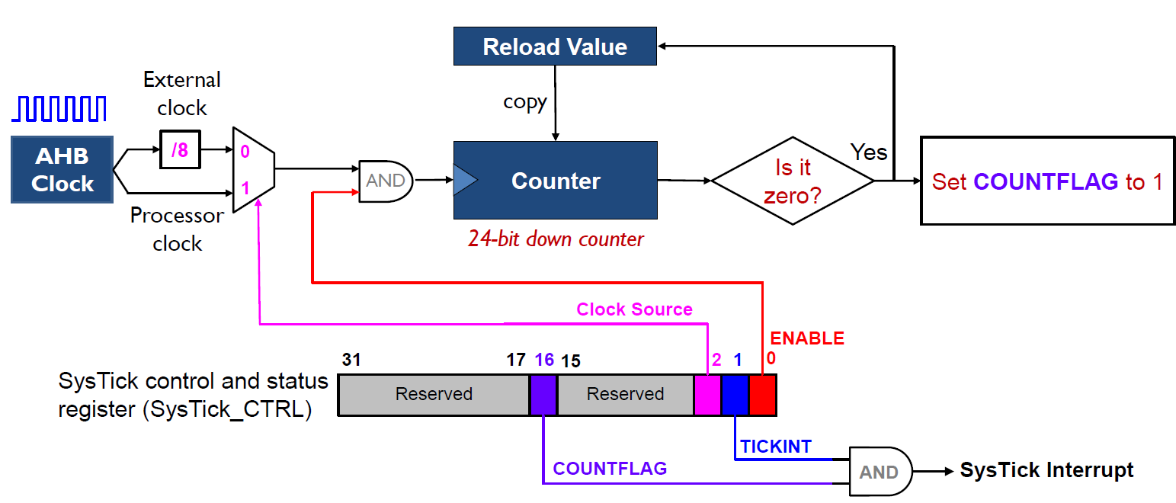
Functional Diagram of System Timer (SysTick)
System timer is a standard hardware component built into ARM Cortex-M.

Slide 6
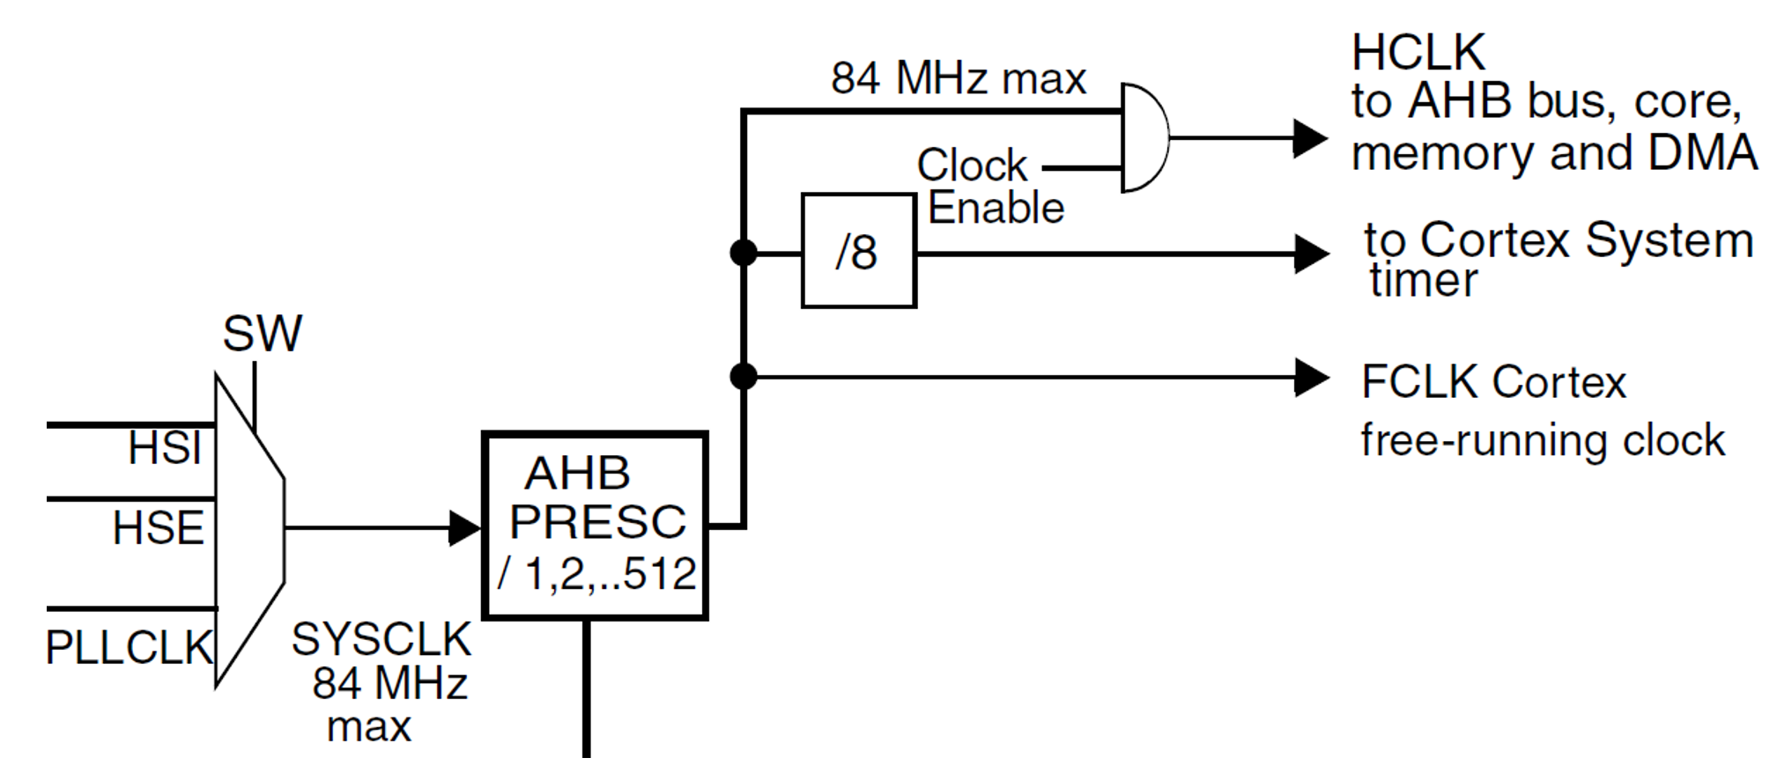

Clock tree
The RCC feeds the external clock of the Cortex System Timer (SysTick) with the AHB clock (HCLK) divided by 8.
The SysTick can work either with this clock or with the Cortex clock (HCLK), configurable in the SysTick control and status register.

Slide 7
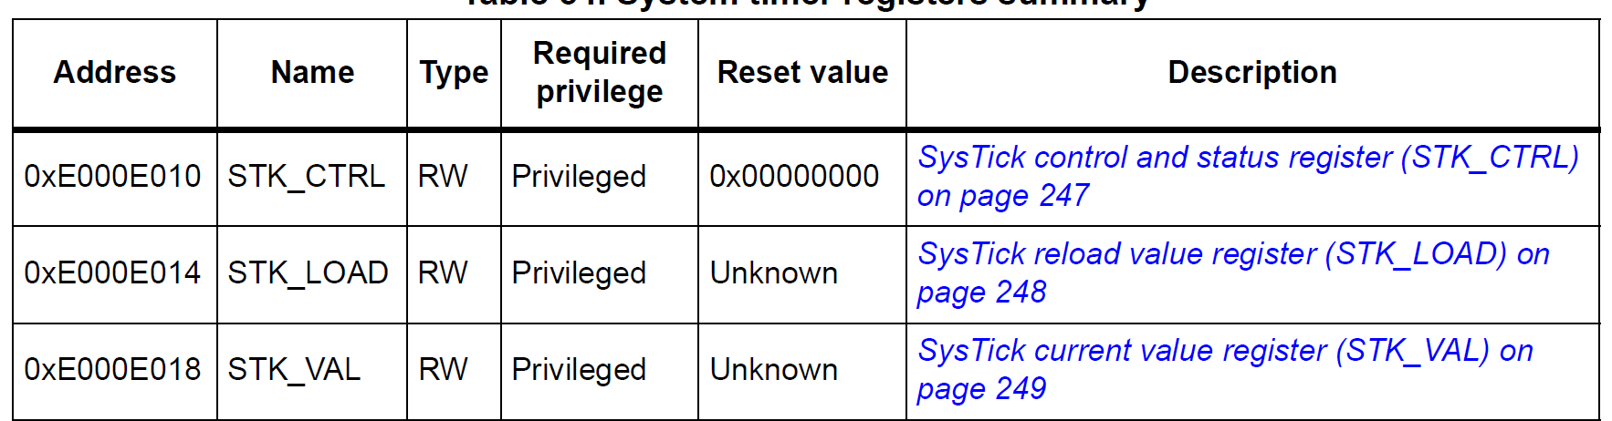
Registers of System Timer

Slide 8
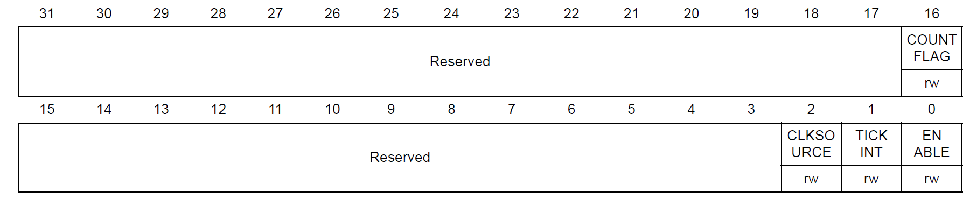
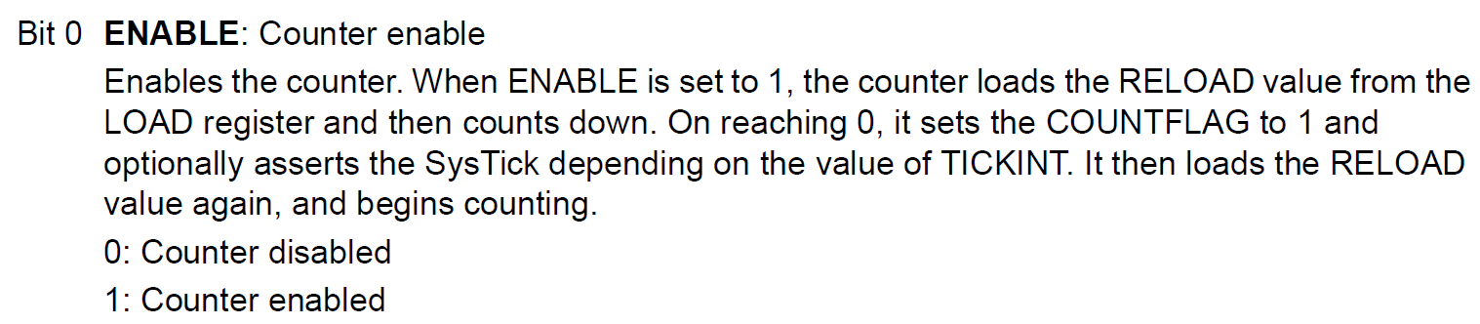
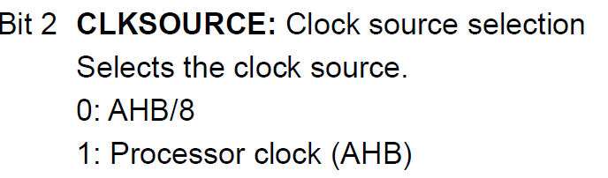
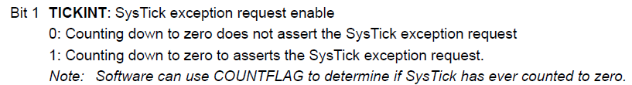
SysTick control and status register (STK_CTRL)
The SysTick CTRL register enables the SysTick features.

Slide 9
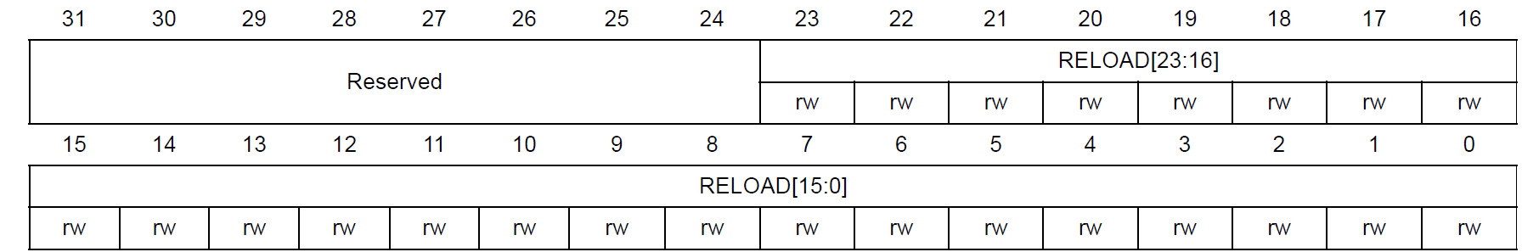
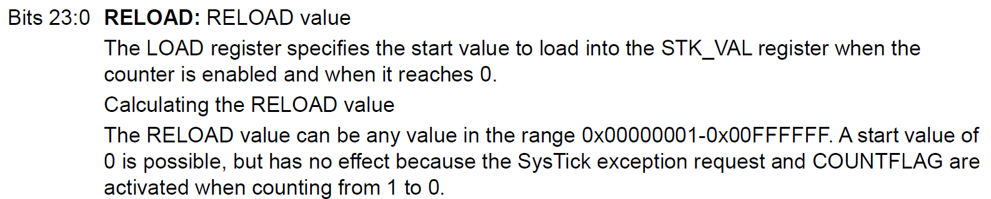
SysTick reload value register (STK_LOAD)

Slide 10
SysTick Load Value Formula
24 bits, maximum value 0x00FF.FFFF (16,777,215)
Counter counts down from RELOAD value to 0.
Reload Value (N) = Time Delay / (1 / Clock Frequency);
Reload Value (N) = Time Delay * Clock Frequency
Example
For a Time Delay of 1 second and a Clock Frequency of 16 MHz
Reload Value (N) = 1 / (1 / 16000000)
Reload Value (N) = 16000000
Clock Frequency: The clock frequency driving the SysTick timer (in this case, 16 MHz or 16,000,000 Hz).
Time Delay: The desired delay time, in seconds (in this case, 1 second).
The formula calculates how many clock cycles are needed to achieve the specified delay.
In this example, you need 16 million clock cycles to create a 1-second delay with a 16 MHz clock.
So, the LOAD register should be set to 16,000,000 to create a 1-second delay if the clock frequency is 16 MHz.

Slide 11
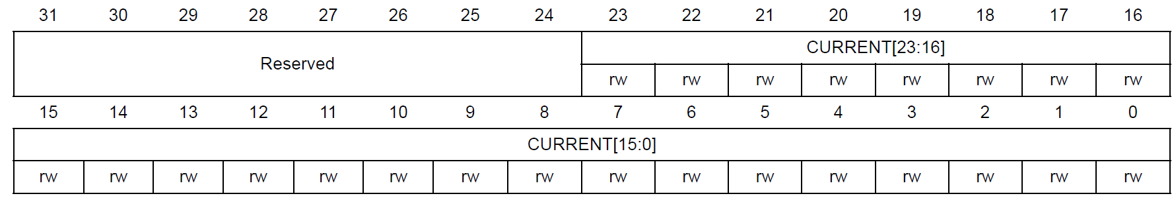
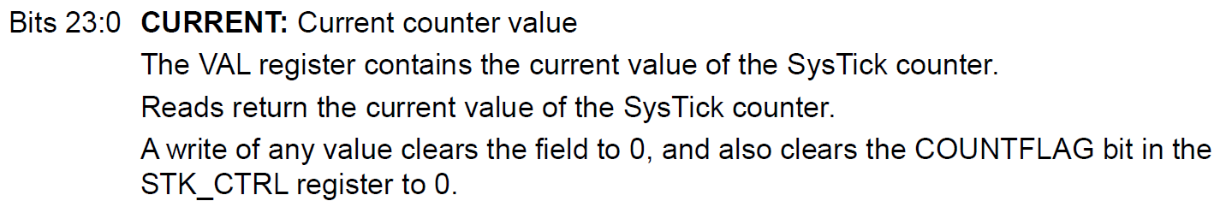
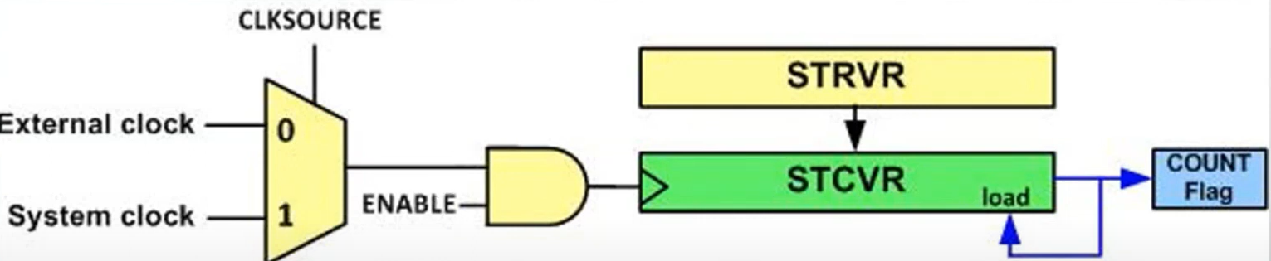
SysTick current value register (STK_VAL)

Slide 12
SysTick design hints and tips
The SysTick counter reload and current value are undefined at reset, the correct initialization sequence for the SysTick counter is:
1.Program reload value.
2. Clear current value.
3. Program Control and Status register.

Slide 13
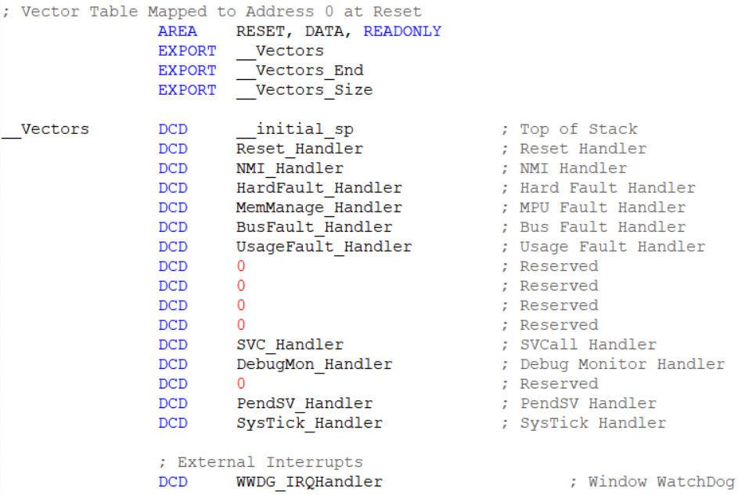
SysTick design hints and tips

Slide 14

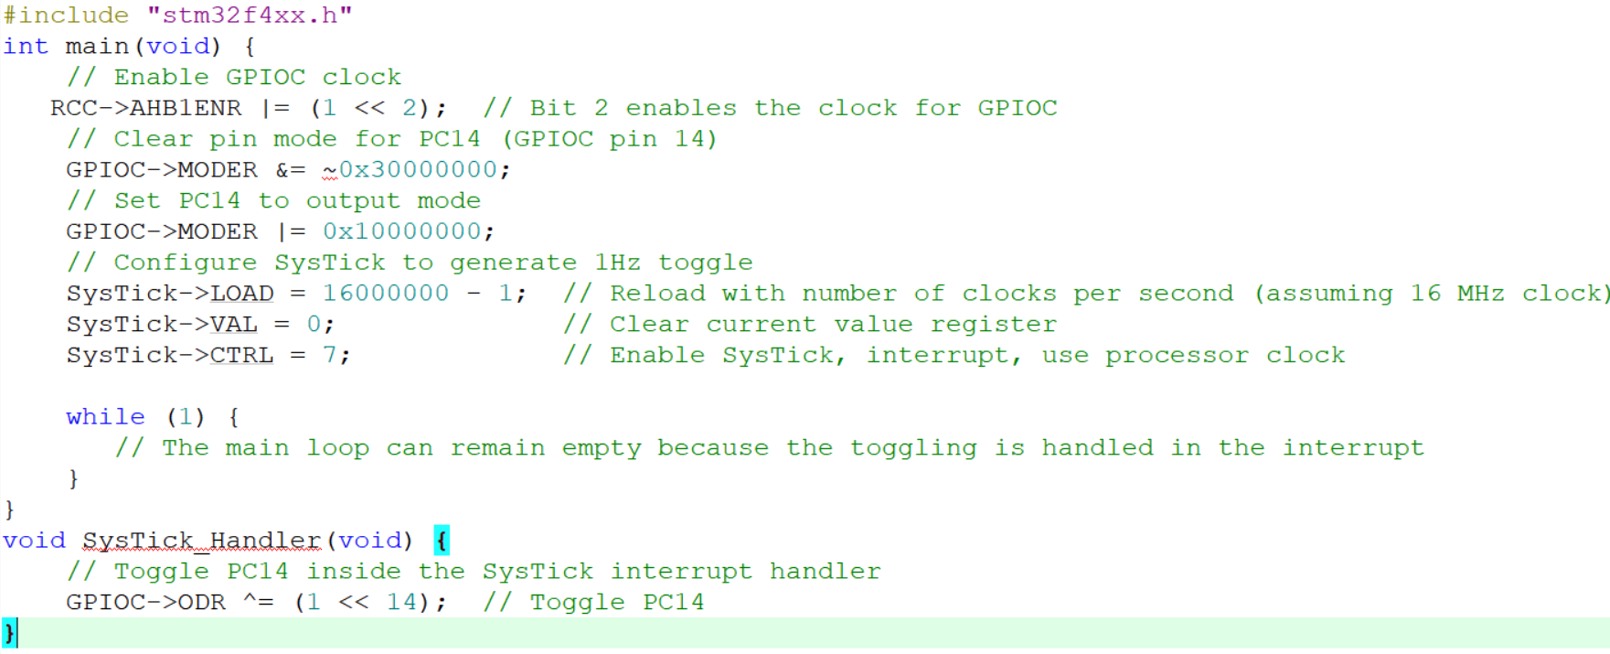
Toggle PC14 (LED1) with 1 s delay using SysTick Interrupt

Slide 15
Thank You

